Slide 1







Slide 2

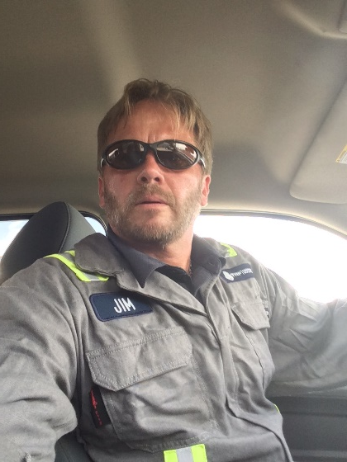

Thigpen Energy HS&E Commitment
Impeccable safety record
ISNetworld Approved for
  CenterPoint Energy
  Kinder Morgan
  ATMOS Energy
  Shell
  Apache
  Anadarko
  Lewis Energy
  Newfield Exploration
Member of Energy Worldnet
Member of DISA
Our goal is 100% customer satisfaction while providing the safest work practices possible
Here at Thigpen Energy, we take safety very seriously. Our company’s culture is one of safety above all else and customer satisfaction in a close second place. It is those core values that drive our successes…period!
– Jim Schauer
CEO, Thigpen Energy

Slide 3

Randall Hackworth

Slide 4
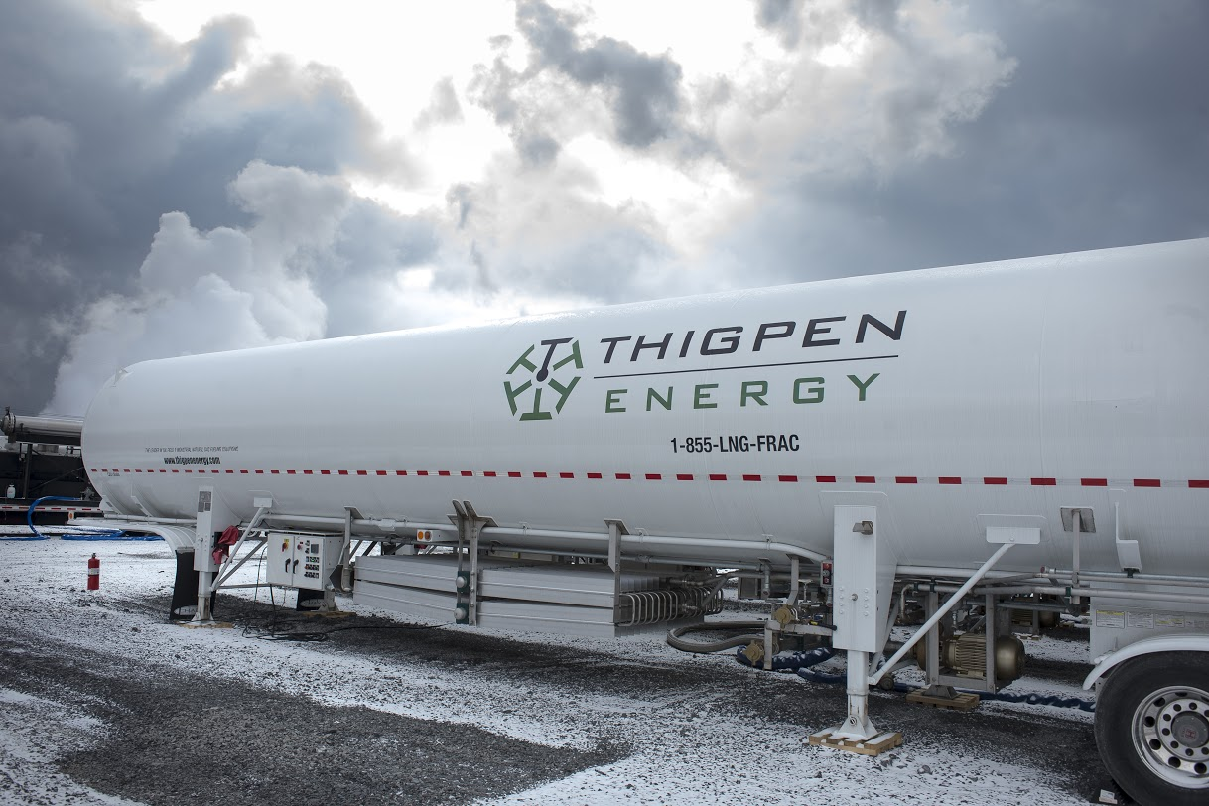

Benefits and Efficiencies of LNG
LNG- Cryogenic to minus -265 degrees. 97% + Pure Methane
One LNG tanker 830 MCF vs CNG tube truck of 140 MCF
Efficient- One (1) LNG tanker can deliver 100 MCF/D for 8 days vs SIX (6) CNG tube trailers
LNG low pressure (5-70 psi)

Slide 5


Natural Gas Supply Disruption
If it is the Safe and Reliable Natural Gas Grid, then why are there supply disruptions?

Slide 6
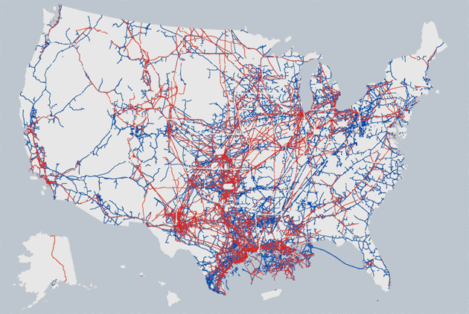
Natural Gas Supply Disruption
Rather…It is from maintaining the most reliable and safest natural gas infrastructure and grid, that there WILL be potential NG supply disruptions…

Slide 7
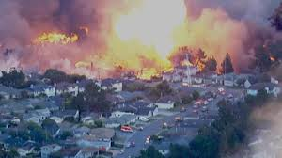
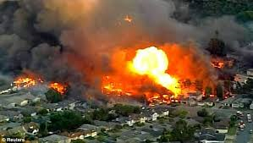
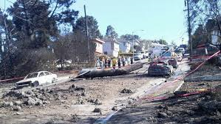
PG&E San Bruno, CA 30”

Slide 8
Natural Gas Supply Disruption
Winter Curtailment and Supply
  Pipeline Safety and Maintenance Ops aka…“Integrity Projects”
      Emergency Situations

Slide 9
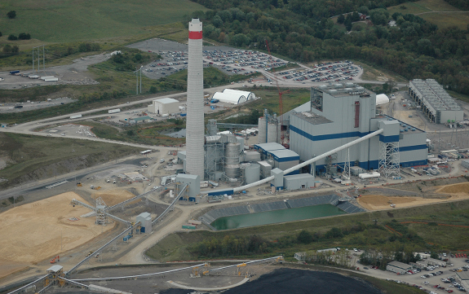
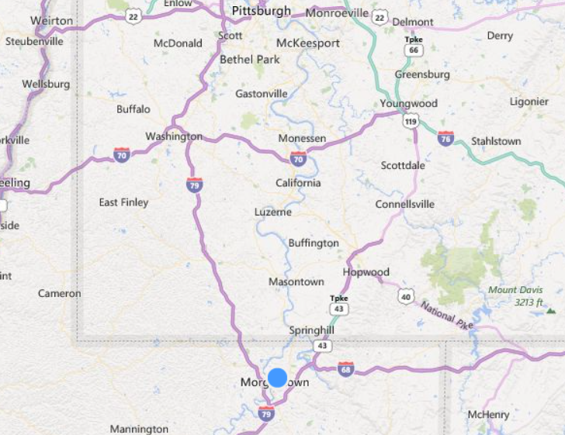
Longview Power Case Study
Case Study: Longview Power Maidsville, WV
  Longview Power is a 700 megawatt (net) electrical power generating facility located in Maidsville, West Virginia. At a cost of approximately $2.0 billion, Longview is the largest privately-funded project in state history. * (www.longviewpower.com)
  In October 2014, Thigpen Energy was contracted by Longview Power to provide one of the country’s largest LNG virtual pipeline solutions to date

Slide 10
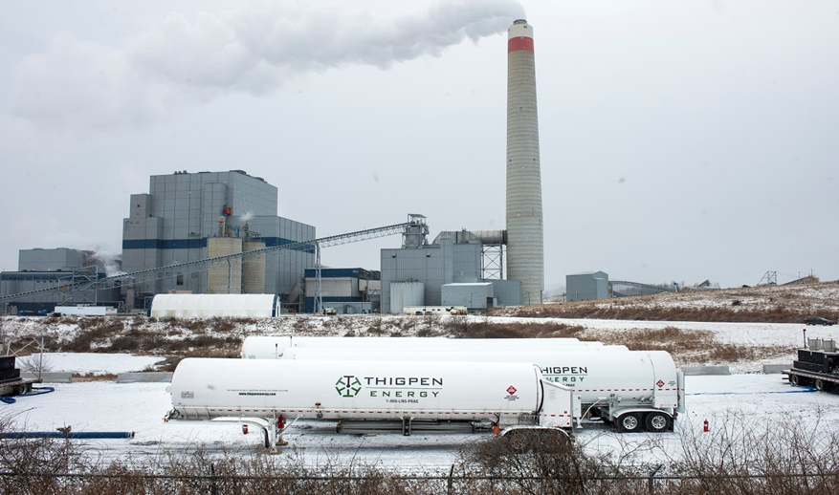
Longview Power Case Study
Longview Power Generation Maidsville, WV
Primary Energy Source-Coal
Natural Gas Ignition- Dominion Pipeline-Sole Source
Requires 1,600-1,900 MCFH for 7-10 Hours
ISSUE-Both Winter Curtailment and Integrity Ops
Thigpen’s virtual LNG pipeline solution for Longview Power

Slide 11
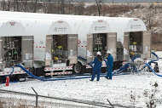
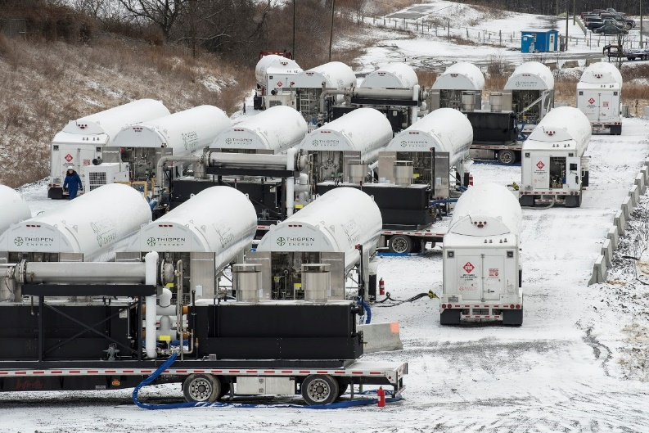
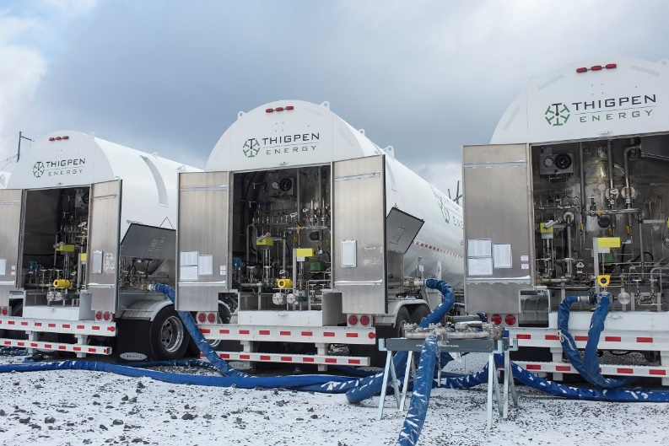
Longview Power Case Study

Slide 12
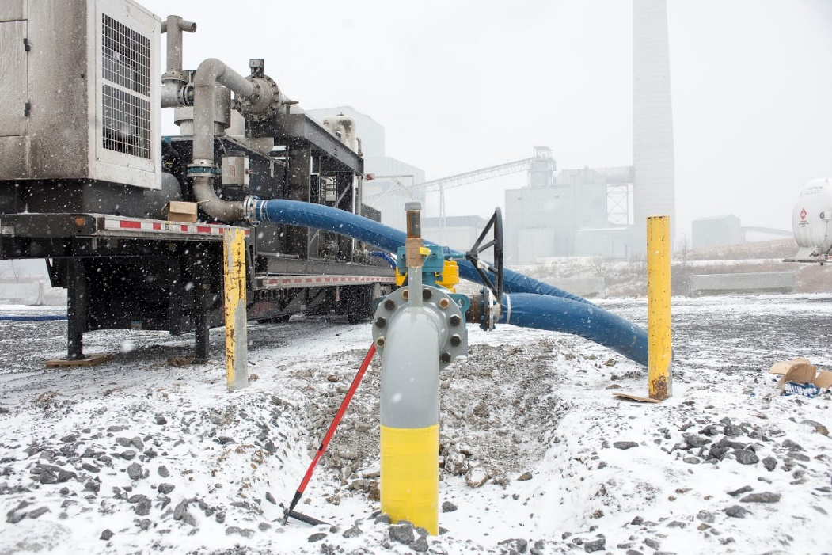
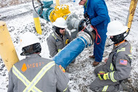
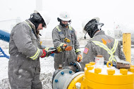
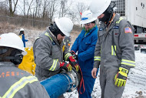
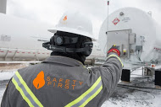
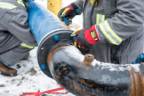
Longview Power Case Study

Slide 13
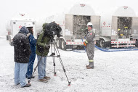
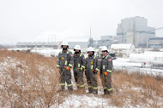
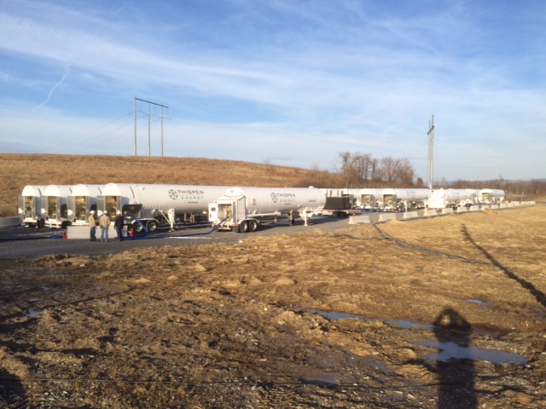
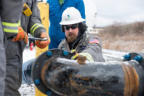
Longview Power Case Study

Slide 14
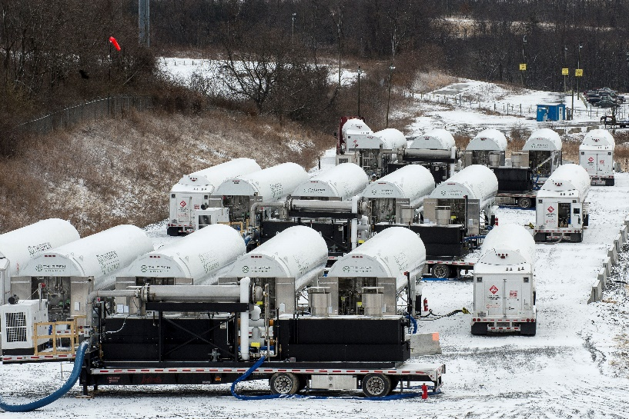
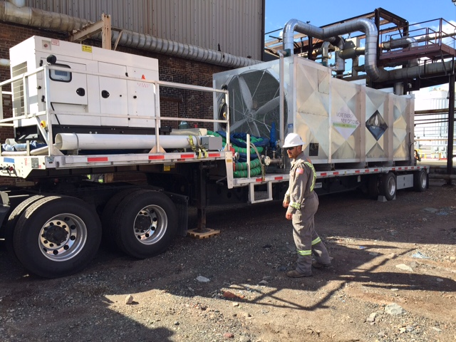
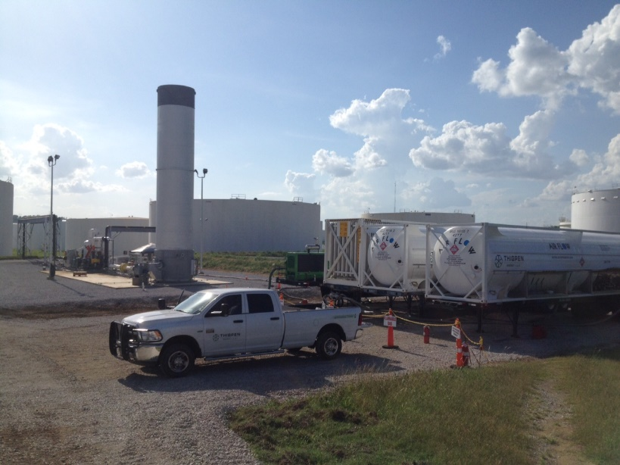
INDUSTRIAL & PIPELINE EXPERIENCE

Slide 15
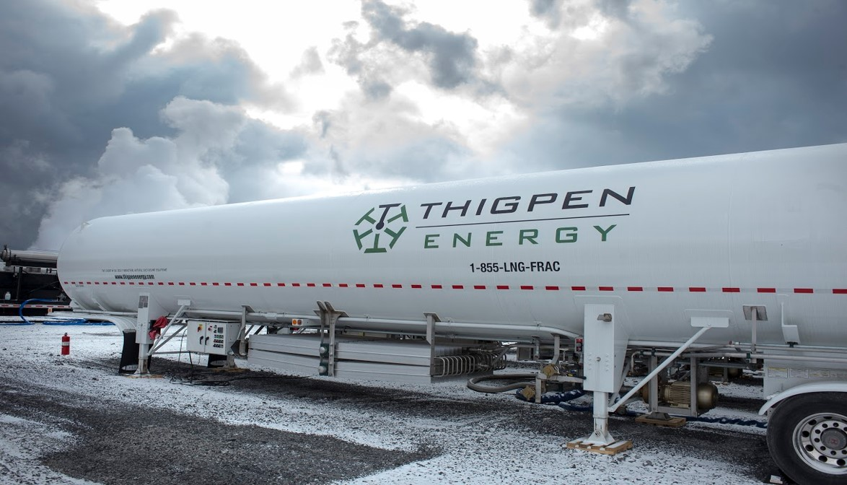
Thigpen Energy Virtual Pipeline

Slide 16



Contact Us

