Slide 1
2015 TGA Safety Roundtable

Slide 2
Digging Dangers: The Power of Pipelines - Final Proof
http://www.youtube.com/watch?v=VUtrzxJIEbE

Slide 3
Top Ten Root Causes as Reported to TDRF January 2014 - December 2014

Slide 4
Top Ten by Type of Excavator
as Reported to TDRF
January 2014 - December 2014

Slide 5
Top Ten Damages by Type of Work Performed
as Reported to TDRF
January 2014 - December 2014

Slide 6
Top Ten Damages by Type of Equipment
as Reported to TDRF
January 2014 - December 2014

Slide 7
NPMS (National Pipeline Mapping System)

Slide 8
Texas Utility Code-Title 5, Chapter 251
Class “A” Operators must join Notification Center
(Electric, Telephone, Cable, Gas, Oil, Steam, Co2, etc.)
Class “B” Operators may participate voluntarily
(Water, Sewer, Slurry)
Advance Notice Required (At Least 2 working days, not more Than 14-Days, excluding Sat, Sun, Holidays)
Each Operator Notified must respond within 2 working days
(Positive Response)

Slide 9
National 811 Number
All calls are rotated between the two One Call Centers operating in the State.
TX811
LSNC
LSNC
Simply put, it is a speed-dial number to get in touch with a One Call Center.
Notes:
For the first time, through the establishment of 811, the three-digit “Call Before You Dig” number.
All stakeholders can reach a call center using their Phone with three easy numbers.
When someone dials 811, they are automatically be connected to one of the three centers operating in Texas.
Call are directed to the state one call number and sent out on a rotating basics, so you will be connected to one of the three call centers.
National implementation is due to be completed in Middle April 2007. May 1, 2007 for Texas.

Slide 10
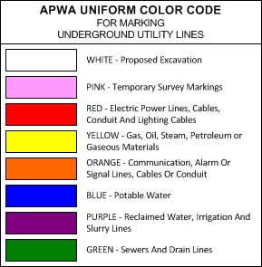
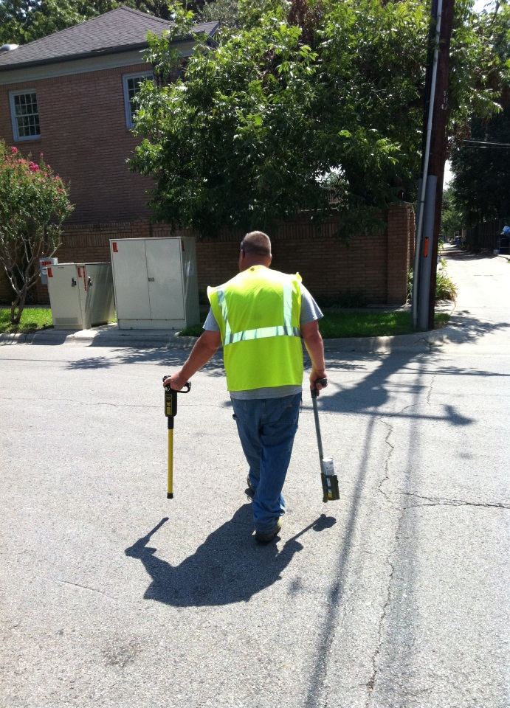
Facility/Utility Response

Slide 11
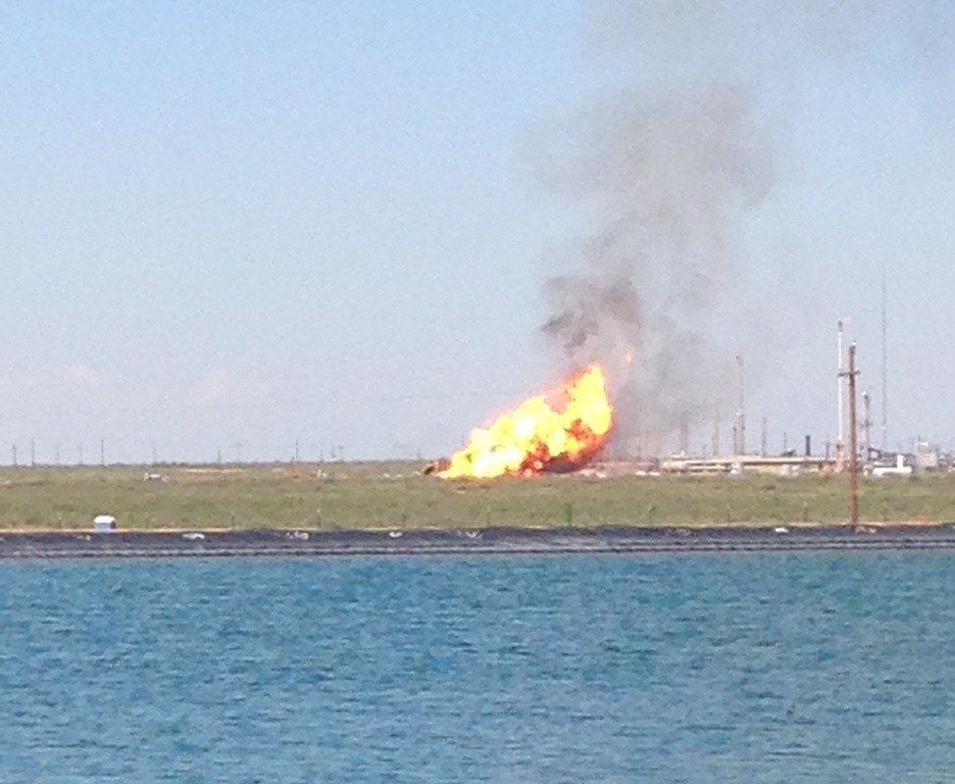
Martin County, September 2014

Slide 12
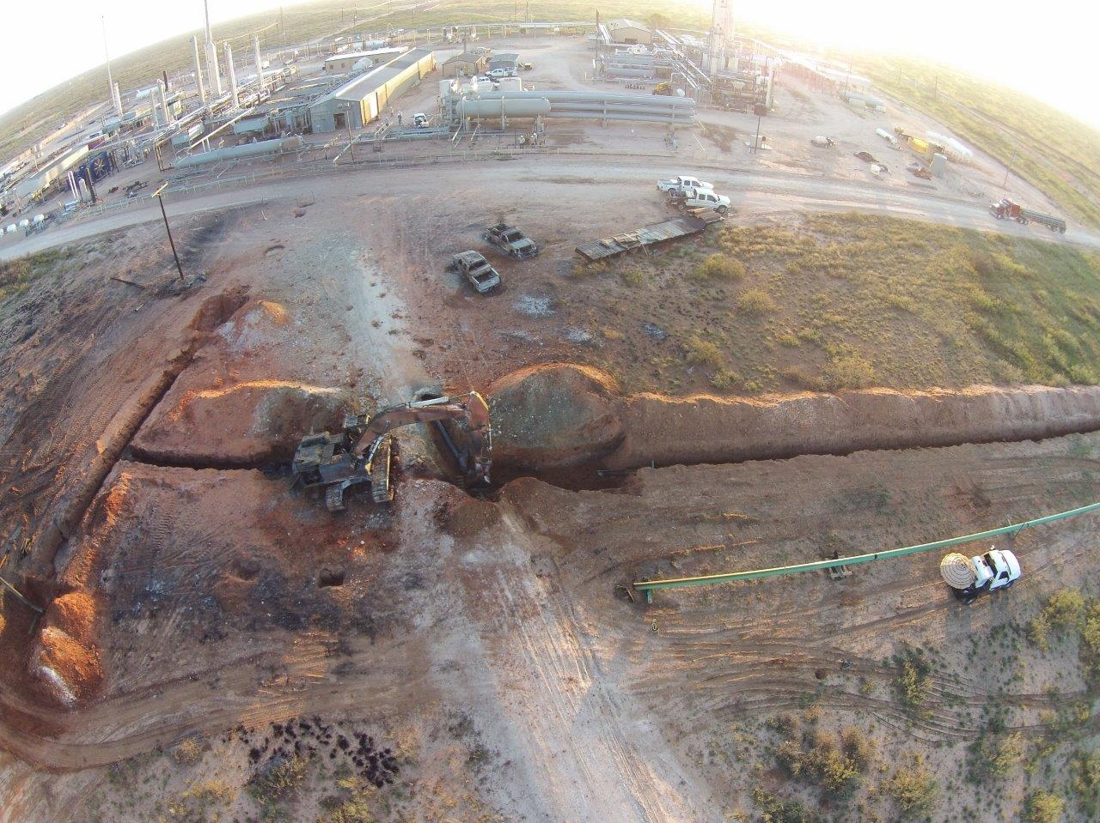

Slide 13
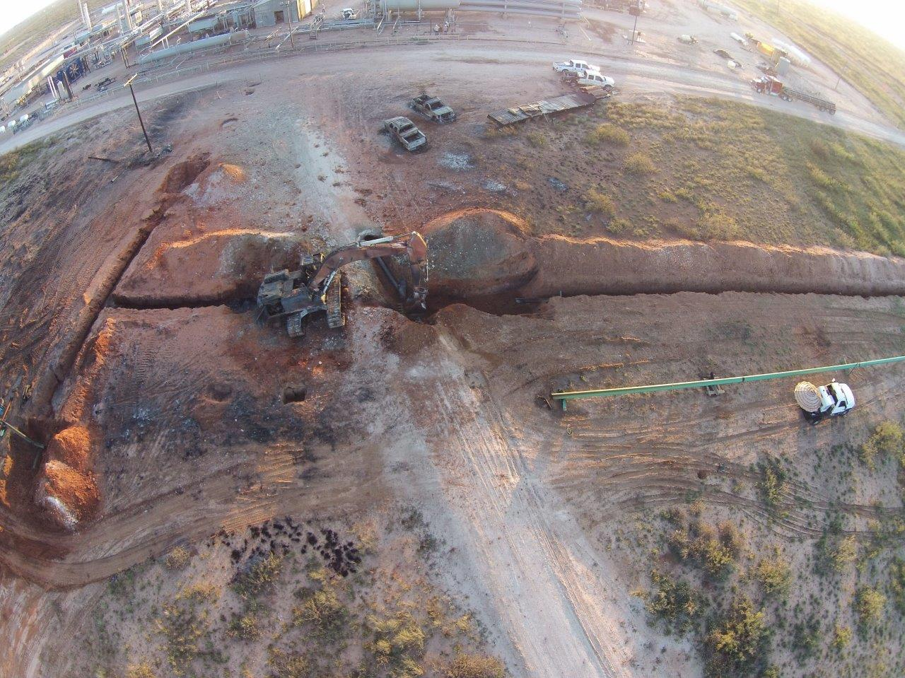

Slide 14
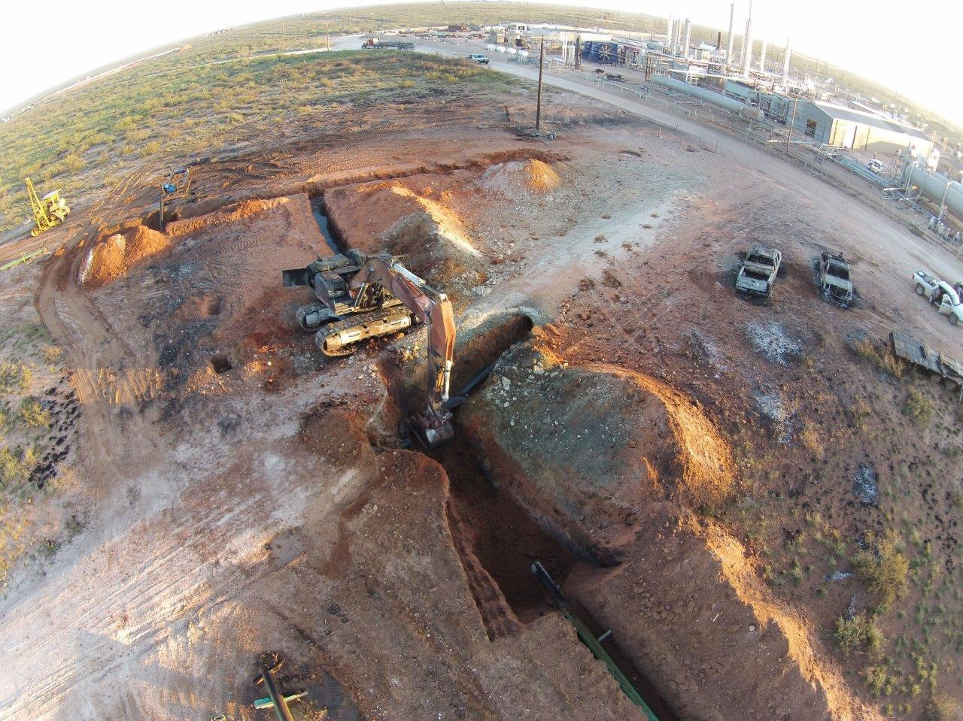

Slide 15
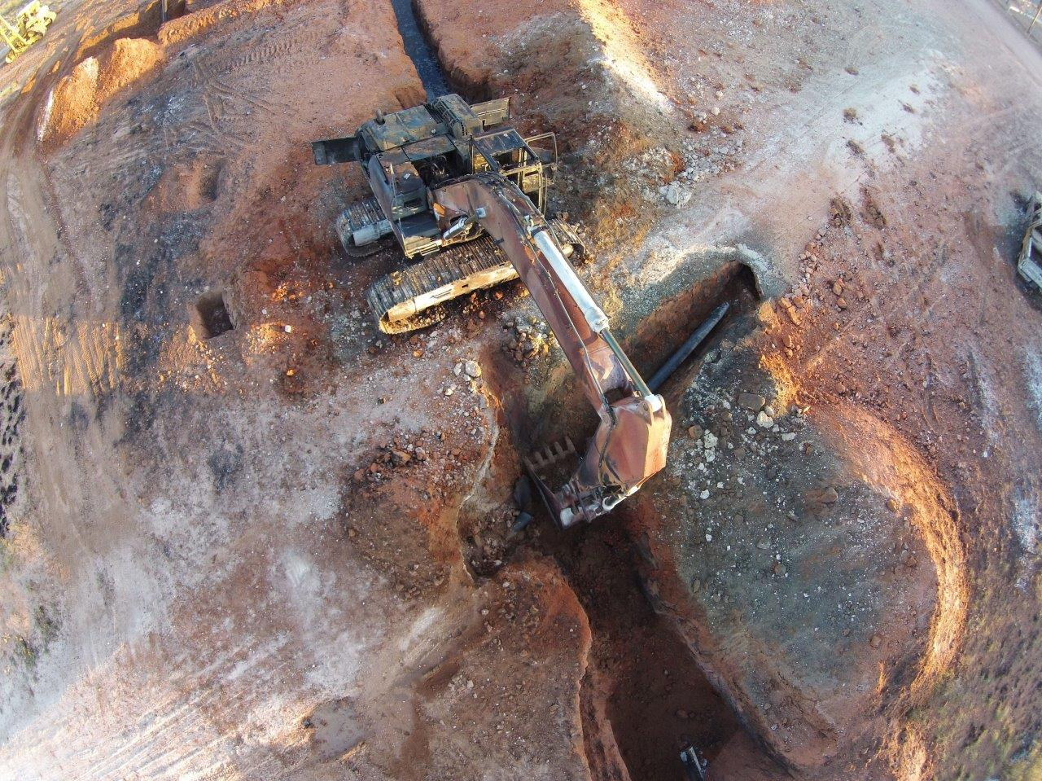

Slide 16
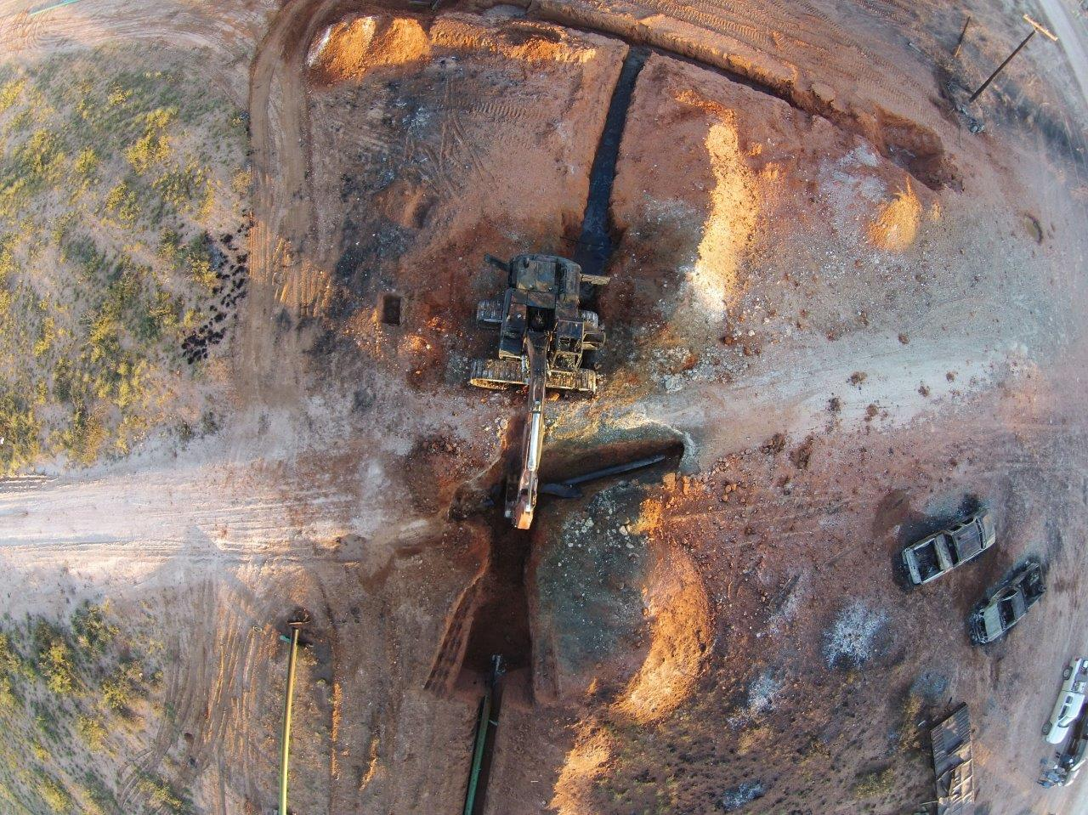

Slide 17
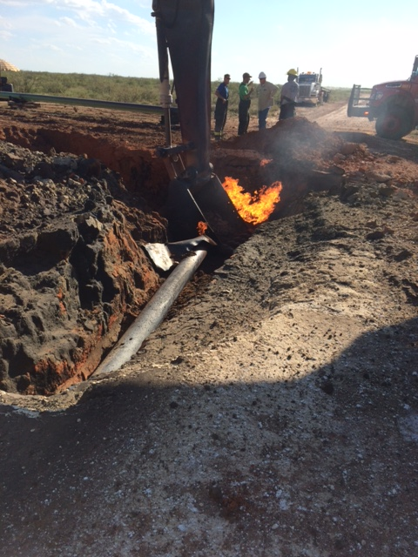

Slide 18
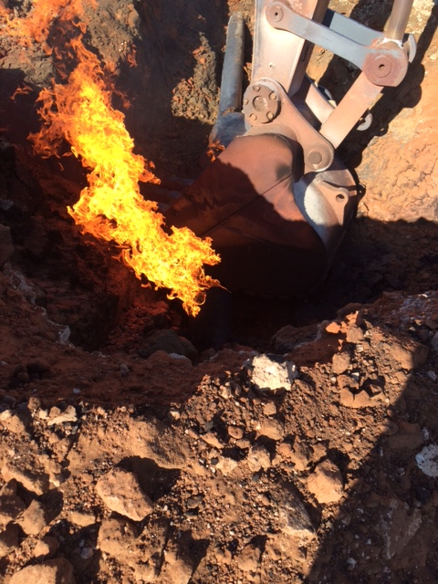

Slide 20
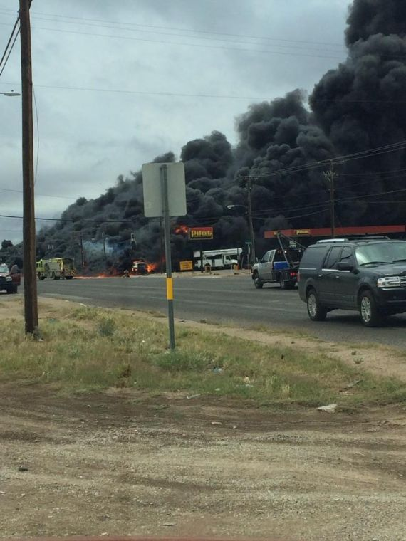
Midland County, May 2014

Slide 21
Four Steps to Safer Excavation
1.
Call-Click BEFORE You Dig
811 OR REMOTE APPLICATION
2.
Wait the required amount of time
Texas law requires at least 2 working days notice
3.
Respect the locate marks
Identify your construction zone in white.
Observe the Uniform Color Code.
If marks are removed or altered, call for a re-mark
4.
Dig with care
Follow safe excavation practices and hand dig when appropriate.

Slide 22
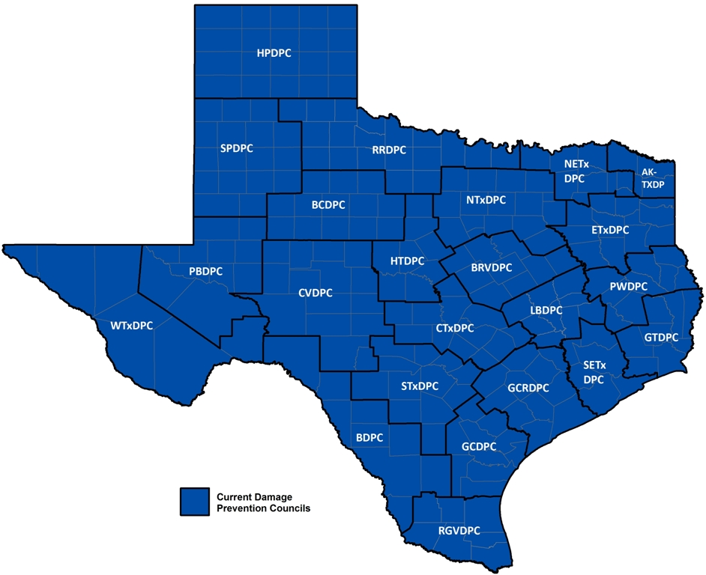
DAMAGE PREVENTION COUNCILS of TEXAS

Slide 23
Gas Pipeline Explosion – North Texas
http://www.youtube.com/watch?v=RSCz-35M9hA

