Slide 1
Bloodborne Pathogens
Texas Gas Association
Safety Roundtable
March 2015

Slide 2
Bloodborne Pathogens

Slide 3
Objective
Share understanding and knowledge necessary to help reduce or eliminate the occupational risk of exposure to bloodborne pathogens in the workplace.
Understand the risks and develop behaviors that will help protect employees when they are exposed to blood or other potentially infectious material.

Slide 4
Bloodborne Pathogens
OSHA’s Bloodborne Pathogen Standard (29 CFR 1910.1030) provides safeguards to protect workers against the health hazards from exposure to blood and other potentially infectious materials, and to reduce their risk from this exposure.

Slide 5
Exposure Control Plan
Outlines strategies necessary to eliminate or minimize employee exposure to blood and other body fluids.
Engineering and Work Practice Controls
Personal Protective Equipment
Training
Housekeeping
Containment / labeling potentially infectious material
Investigation & Evaluation

Slide 6
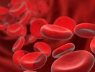
What are Bloodborne Pathogens
Microorganisms (such as viruses) transmitted through blood, or other potentially infectious material such as certain body fluids (semen, breast milk, etc.) or tissues.

Slide 7
Chain of Infection
A pathogen must be present.
There must be an adequate quantity of the pathogen to overwhelm the immune response.
There must be a suitable entry site for the pathogen to enter the body.
The person must have a susceptibility to the pathogen.
Notes:
Exposure to a pathogen does not mean that a disease will occur. It depends on whether all conditions of the chain of infection are present. By eliminating at least one condition, infection will not occur.

Slide 8
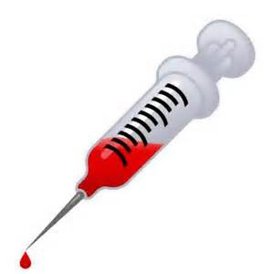
Contamination
Bodily fluids, especially those visibly contaminated with blood, are capable of causing disease.
Pathogens can enter your body through a cut in the skin, absorption through membranes of the eyes or mouth.
Can be transmitted sexually.

Slide 9
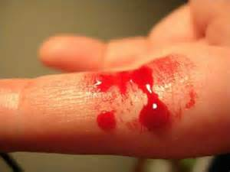
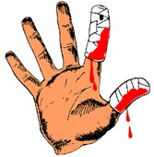
Bloodborne Pathogens
Primary Diseases of Concern
Human Immunodeficiency Virus (HIV)
Hepatitis B
Hepatitis C
Other commonly recognized serious diseases include: Syphilis,
West Nile Virus, Tuberculosis & Influenza

Slide 10
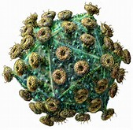
Human Immunodeficiency Virus (HIV)
HIV attacks your body’s ability to protect itself against the disease.
Initially there are no visible signs of having the virus. There is no vaccination for HIV.
HIV virus can live outside the body for only a few hours.

Slide 11
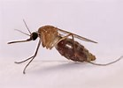
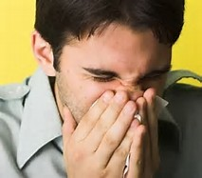
HIV Modes of Transfer
HIV can be transferred from one individual to another by blood, semen, vaginal secretions, breast milk or amniotic fluid.
HIV cannot be transferred by door knobs, drinking fountains, mosquitos, oral secretions, sneezes, toilets or by shaking hands.

Slide 12
HIV Symptoms
Symptoms can vary, but often include:
Weakness Diarrhea
Fever Headaches Sore Throat Weight Loss
Swollen Lymph nodes
White coating on the tongue
Nausea
Symptoms could take years before shown

Slide 13
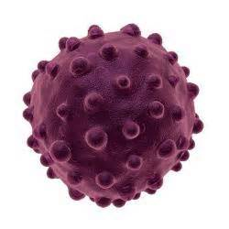
Hepatitis B
10% of those infected become chronic carriers who can infect their families and friend.
300 times easier to catch than HIV.
Can live outside the body for several days.
Approximately 5,000 Americans die of Hepatitis B or its complications each
year.

Slide 14
Hepatitis B Modes of Transfer
Blood, semen, vaginal fluid, birth, sex with infected partner, sharing needles, razors or toothbrushes, exposure to blood from needle sticks or direct contact with blood or open sores.
Cannot be spread by: sharing eating utensils, breastfeeding, hugging, kissing, holding hands, coughing or sneezing.

Slide 15
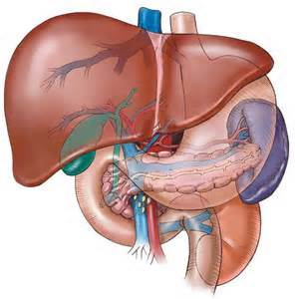
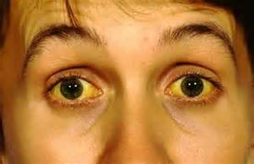
Hepatitus B Symptoms
Flu-like symptoms Liver Inflammation
Fatigue Ulcers on the Colon
Jaundice Loss of Appetite
May be asymptomatic
Severe Joint Pain
Lung Disease

Slide 16
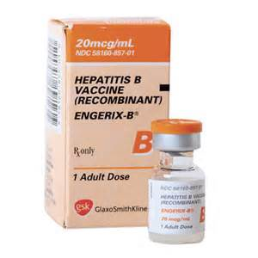
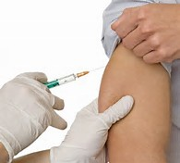
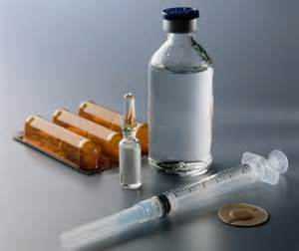
Hepatitis B Treatment
Vaccination available since 1981
85% - 95% effective for healthy adults.
Recombinant DNA technology – no human materials used so no risk of HIV or Hepatitis B.

Slide 17
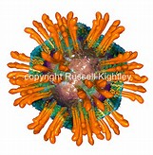
Hepatitis C
3 – 4 million carriers on any given day.
Disease can incubate for decades.
Not related to the virus that causes Hepatitis B. Affects more Americans each year than AIDS.
Primary cause of chronic liver disease.

Slide 18
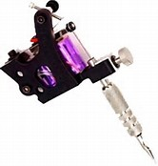
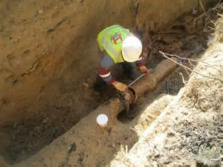
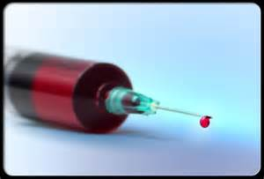
Hepatitis C Modes of Transfer
Drug use – shared needles
Unprotected Sex (multiple partners)
Blood transfusions
Tattooing – shared needles
Body Piercing – shared needles
Exposure to raw sewage

Slide 19
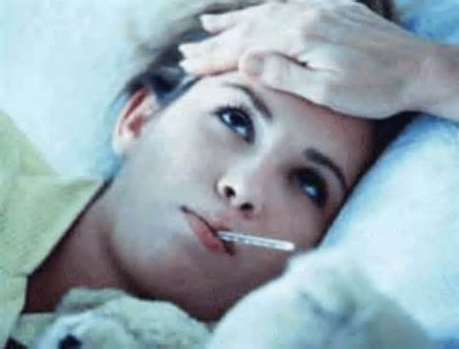
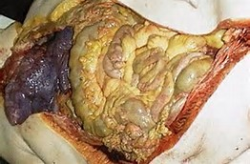
Hepatitis C Symptoms
Flu like symptoms
Fatigue
Fever
Muscle / Joint pain
Inflammation of the liver

Slide 20
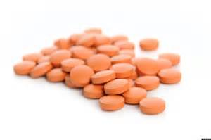
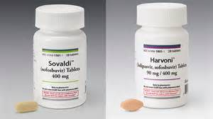
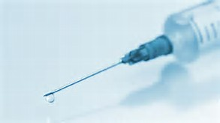
Hepatitis C Treatment
Antiviral medications / early stages
Liver transplant / late stages

Slide 21
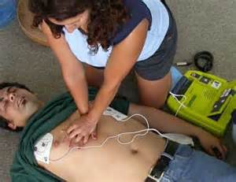
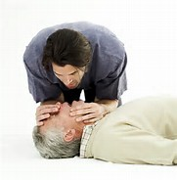
How BBP Spread On The Job
During a first aid or CPR/AED response incident, the potential for exposure to bloodborne pathogens exist if there is blood or other body fluids.
If blood is present in the workplace from an unreported accident or illness, there is potential for exposure.

Slide 22
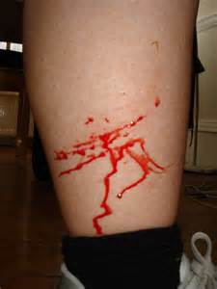
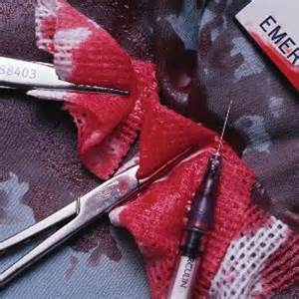
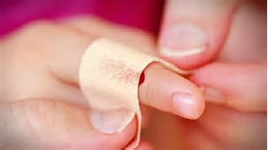
How BBP Spread On The Job
When a contaminated object touches inflamed skin, acne or skin abrasions.
When you touch a contaminated surface and then touch your eyes, nose, mouth or open wounds.

Slide 23
How To Reduce Your Risk
When emptying trash containers, do not use your hands to compress the trash in the bag.
Do not eat, drink, smoke, apply cosmetics or handle contact lenses in areas where there is the possibility of exposure.
Use “Universal Precautions” when exposed to a situation where Bloodborne Pathogens may be present.

Slide 24
Universal Precautions
A system of infection control which assumes that all human blood and certain body fluids are treated as if known to be infectious.

Slide 25
Emergencies
Always use “Universal Precautions” in an emergency situation.
Minimize your exposure by wearing:
gloves
splash goggles
mouth to mouth resuscitations mask
other barrier devices for CPR

Slide 26
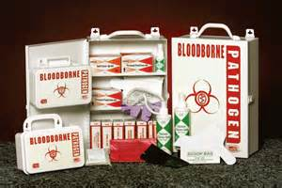
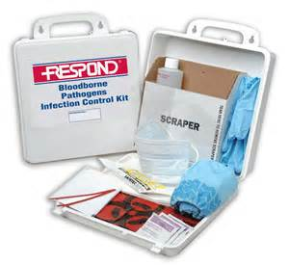
Bloodborne Pathogen Cleanup Kit
Provides sanitary clean-up of body fluids
Protects user from infectious diseases
Provides means of proper disposal of body fluids

Slide 27
Bloodborne Pathogen Cleanup Kit
Contains contents & directions for cleanup
Apron Face Mask
Latex Gloves Shoe Covers
Scraper Paper Towels
Scoop Towelettes
Chlorine Concentrate Biohazard Bag
Absorbent Pack

Slide 28
Proper Glove Removal & Disposal
Grip one glove near the cuff and peel it down until it comes off inside out. Cup the removed glove in the palm of your other hand.
Place two fingers of your bare hand inside the cuff of the remaining glove.
Peel that glove down so that it also comes off inside out and over the first glove.
Dispose gloves in labeled biohazard bag & give to EMS for disposal.

Slide 29
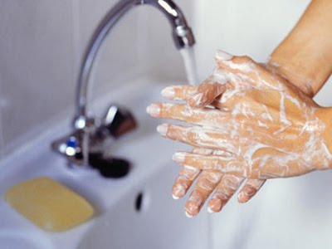
Hand Washing
Hand washing is one of the most important practices used to prevent transmission of bloodborne pathogens.
Wash hands or other exposed skin thoroughly with antibacterial soap as soon as possible following and exposure for at least 15 seconds.

Slide 30
For additional information visit
www.osha.gov
29 CFR 1910.1030

